Slide 1
Two-Dimensional Arrays and Nested Loops – part 3
Barb Ericson
Georgia Institute of Technology
August 2005

Slide 2
Learning Goals
Understand at a conceptual and practical level
  How to copy pixels from one picture to another
  How to declare, initialize and change several variables in a for loop
  How to copy pixels from one picture to a specified location in another picture

Slide 3
Copying Pixels to a New Picture
Need to track the source picture x and y
  And the target picture x and y
We can use a blank picture
  As the target picture
Several blank pictures are available
  640x480.jpg
  7inX95in.jpg
1 | 2
3 | 4
1 | 2
3 | 4

Slide 4
Copy Picture Algorithm
Copy a picture to the 7 by 9.5 inch blank picture
  Create the target picture object
  Invoke the method on the target picture
    Create the source picture object
    Loop through the source picture pixels
      Get the source and target pixels
      Set the color of the target pixel to the color of the source pixel

Slide 5
Copy Algorithm to Code
Loop through the source pixels
  // loop through the columns
  for (int sourceX = 0, targetX = 0;
  sourceX < sourcePicture.getWidth();
  sourceX++, targetX++)
  {
  // loop through the rows
  for (int sourceY = 0, targetY = 0;
  sourceY < sourcePicture.getHeight();
  sourceY++, targetY++)
  {

Slide 6
Copy Algorithm to Code – Cont
Get the source and target pixels
  sourcePixel = sourcePicture.getPixel(sourceX,sourceY);
  targetPixel = this.getPixel(targetX,targetY);
Set the color of the target pixel to the color of the source pixel
  targetPixel.setColor(sourcePixel.getColor());

Slide 7
Copy Method
public void copyKatie()
{
String sourceFile =
FileChooser.getMediaPath("KatieFancy.jpg");
Picture sourcePicture = new Picture(sourceFile);
Pixel sourcePixel = null;
Pixel targetPixel = null;
// loop through the columns
for (int sourceX = 0, targetX = 0;
sourceX < sourcePicture.getWidth();
sourceX++, targetX++)
{

Slide 8
Copy Method - Continued
// loop through the rows
for (int sourceY = 0, targetY = 0;
sourceY < sourcePicture.getHeight();
sourceY++, targetY++)
{
// set the target pixel color to the source pixel color
sourcePixel = sourcePicture.getPixel(sourceX,sourceY);
targetPixel = this.getPixel(targetX,targetY);
targetPixel.setColor(sourcePixel.getColor());
}
}
}

Slide 9
Trying the copyKatie Method
Create a picture object using the 7inX95in.jpg file in the mediasources directory
  Picture p1 = new Picture(FileChooser.getMediaPath(“7inX95in.jpg”));
Show the picture
  p1.show();
Invoke the method on this picture object
  p1.copyKatie();
Repaint the picture
  p1.repaint();

Slide 10
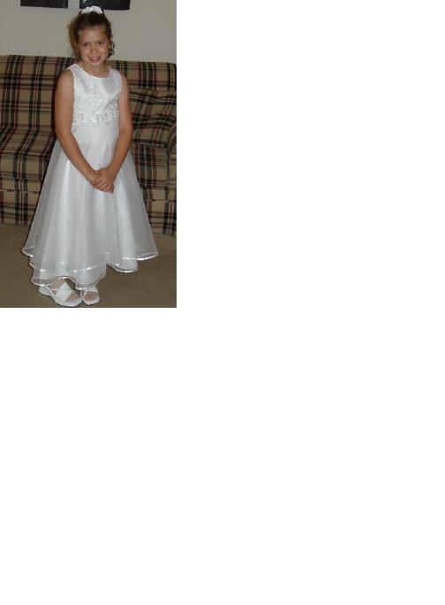
Result of copyKatie Method

Slide 11
Copying Pixels to a New Picture
What if we want to copy the target to a different location in the source
  Than 0,0
  Say startX and startY
What is an algorithm that will do this?
0
1
0
1 | 2
3 | 4
1
0
1
2
3
0
 |  | 1 | 2
 |  | 3 | 4
1
2
3

Slide 12

Copy to Position Exercise
Write a method copyRobot to copy
  robot.jpg
  To location
    100, 100 in 7inx95in.jpg
Test with
  String file = FileChooser.getMediaPath(“7inx95in.jpg”);
  Picture p = new Picture(file);
  p.copyRobot();
  p.show();

Slide 13
Summary
To copy pixels from one picture to another
  Keep track of the sourceX, sourceY and targetX and targetY
You can declare, initialize, and change more than one variable in a for loop
    for (int sourceX = 0, targetX = 0; sourceX <
    sourcePicture.getWidth();
    sourceX++, targetX++)
To copy one picture to a location in another
  Just change the start values for targetX and targetY

